Slide 1
A safe/supportive learning environment
We will be using lyrics from popular hip-hop songs late in the lesson. There is a censored version of the data if someone finds it objectionable.

Slide 2


H_other_wordcloud_libs.R

Slide 3
Let’s make some pyramids

Slide 4

Steps for a pyramid plot…collapse
Combined/Collapsed
into a 2 document corpus
CorpusA – 1000 Tweets
Clean & Collapse
CorpusB – 1000 Tweets
Clean & Collapse

Slide 5
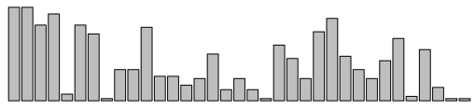
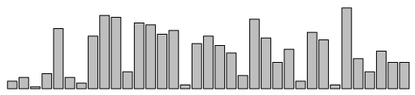
Steps for a pyramid plot…ID common tokens & frequency

Slide 6
Build a “pyramid plot” of frequencies
termA
termB
…
TermN

Slide 7
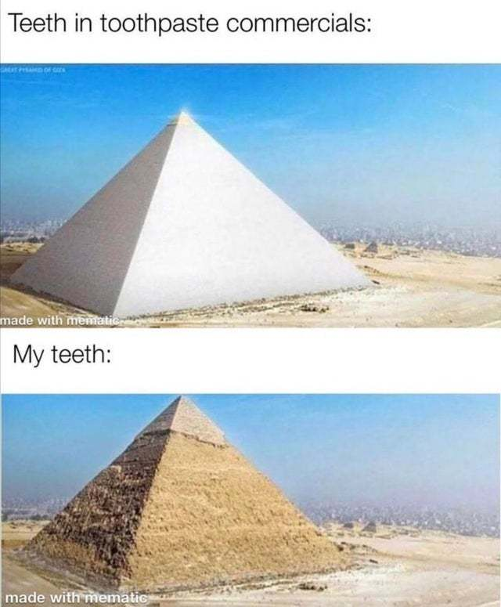
Open ﻿I_Pyramid_plots.R

Slide 8
Open ﻿J_Retailers.R

Slide 9
﻿live_K_RapSongs.R
Optional:﻿
live_K_RapSongs_censored.R

